Slide 1
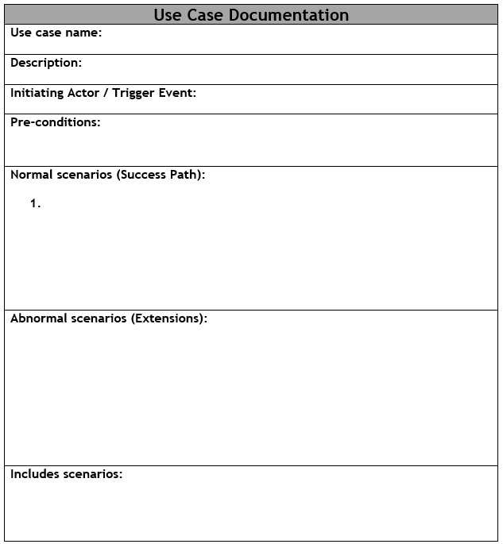
Anatomy of a Use Case Description

Slide 2


Anatomy of a Use Case Description

Slide 3
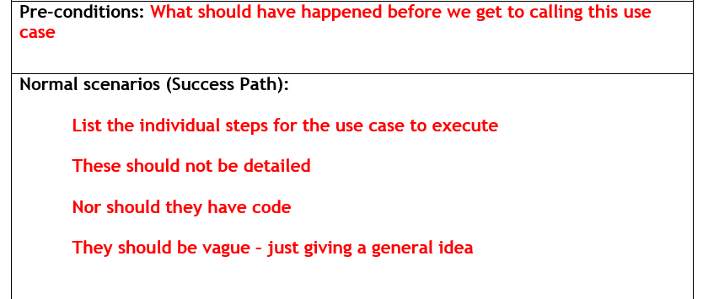
Anatomy of a Use Case Description

Slide 4
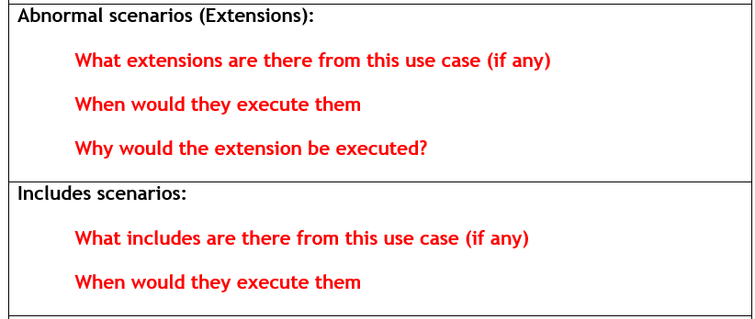
Anatomy of a Use Case Description

Slide 5
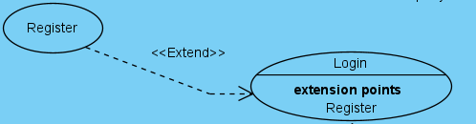
Login for Online Shop - Example

Slide 6


Login for Online Shop - Example

Slide 7



Login for Online Shop - Example

